Slide 2
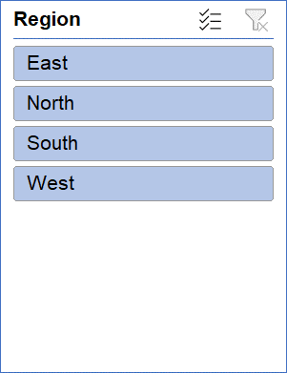
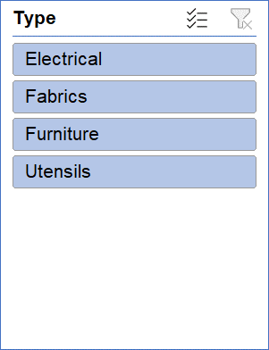
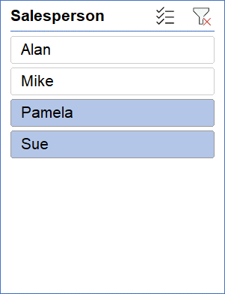
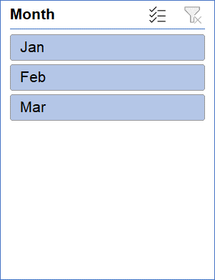
Sum of Sales | Month
Type | Jan | Feb | Mar | Grand Total
Electrical | 8236 | 790 | 1370 | 10396
Fabrics | 4200 |  | 1890 | 6090
Furniture | 1450 | 7545 | 3450 | 12445
Utensils |  |  | 1845 | 1845
Grand Total | 13886 | 8335 | 8555 | 30776

